Slide 1

CAR SALES ANALYSIS (EDA)
By Anurag Gupta

Slide 2
Introduction
The dataset consists of information collected from Car Sale Advertisements for study/practice purpose where most of them are used cars. In this Exploratory Data Analysis (EDA), we are trying to analyze the Car Sales data and find interesting correlations between various features of the car.

Slide 3
Problem Statement
The notebook explores the basic use of Pandas and will cover the basic commands of Exploratory Data Analysis(EDA) which include cleaning, munging, combining, reshaping, slicing, dicing, and transforming data for analysis purpose.
EDA is a critical and first step in analyzing the data and we do this for below reasons :
Finding patterns in Data
Determining relationships in Data
Checking of assumptions
Preliminary selection of appropriate models
Detection of mistakes

Slide 4
Key Observations
The dataset comprises 9576 observations of 10 columns.
Car, Model, Year, Body, Mileage, engV, engType, Drive, Registration & Price
Car has high cardinality. 87 distinct values.
Drive and engV have 511 and 434 missing values respectively.
Mileage and Price have 348 and 267 Zeros respectively.
Model has high cardinality. 888 distinct values.
Dataset has 113 duplicate rows.

Slide 5
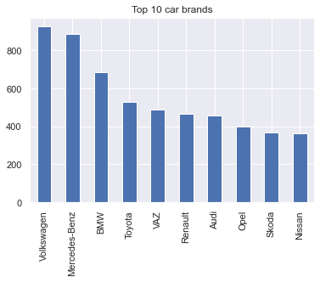
Top 10 Car Brands
Top three preferred car brands are Volkswagen, Mercedes Benz and BMW.

Slide 6
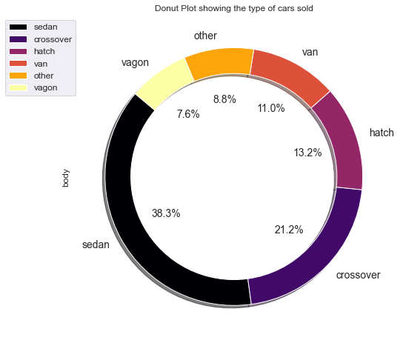
Type of Cars Sold
Sedan is the most sold car type followed by Crossover. This information can be utilized for achieving max sale and production.

Slide 7
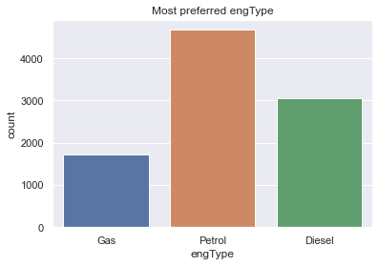
Most Preferred Engine Type
Petrol remains the most preferred engType over the years.

Slide 8
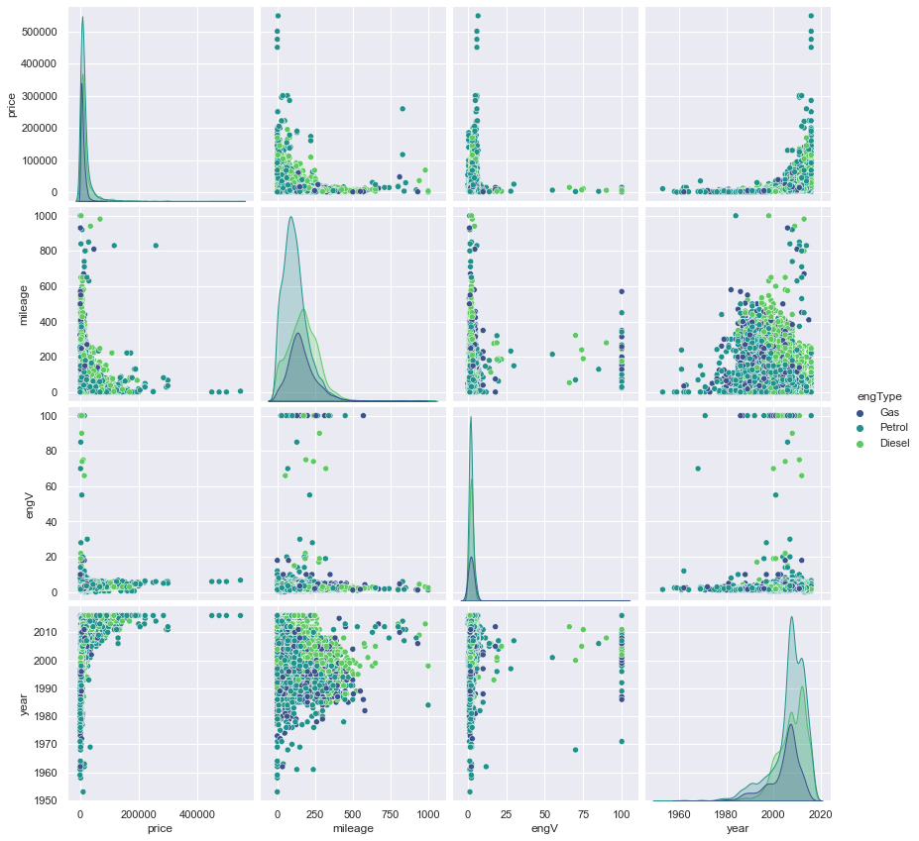
Heatmap of Correlated Features
Price variation based on Year and Mileage
There is increase in Petrol engType cars over the years.
Price also depends on mileage of the car.

Slide 9
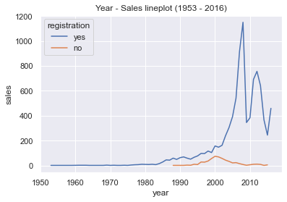
Sales over the Years
Year 2008 witnessed the highest sales. Total sales were much higher during the period after 2005 as compared to the period before 2005.

Slide 10
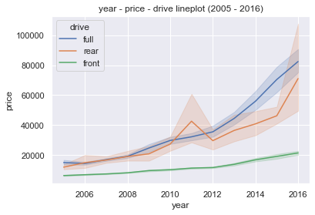
Drive-wise Price Trends
2005 onwards, price increase in full drive cars is much steeper than that in front drive cars. Rear drive cars saw price increase but not as consistent as the other two drives.

Slide 11
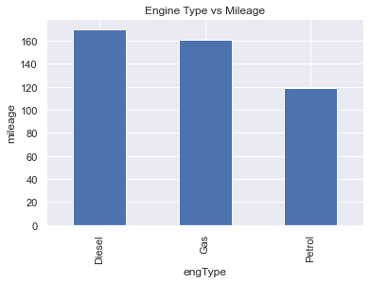
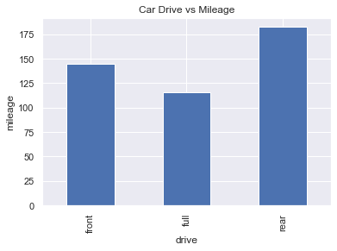
Engine Type & Car Drive Vs Mileage
Engine Type & Car Drive Vs Mileage
- Rear drive cars are more fuel efficient than front and full.
- Diesel cars give better mileage than Gas or Petrol.

Slide 12
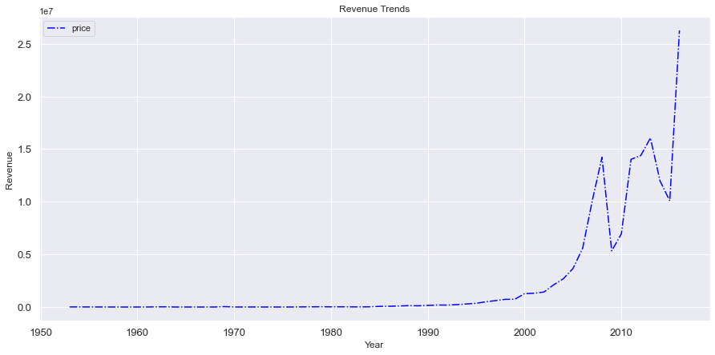
Revenue Trends
Data shows that Revenue remained linear from year 1953 till around 2000. However, that year onwards we see an upward trend though some erratic behavior in between.

Slide 13
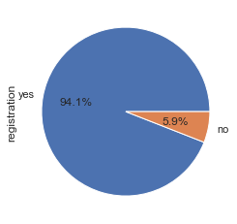
Registration
Of all cars sold ~ 94% had registration whereas 6% did not.

Slide 14
Conclusion
Which brand of cars is most selling brand ?
From analysis, we conclude that Volkswagen and Mercedes-Benz are top most brands and hence these would be preferred choices for people.
Which type of cars are more selling?
Sedan body type has maximum sales over the years. This shows People prefer sedan type of body and hence this information can be used for Sales and Manufacturing. Petrol engine type is preferred over Diesel & Gas.
What are the factors affecting the prices of cars?
Price change is based on mileage and engine type.
Year 2008 witnessed the highest sales. Total sales were much higher during the period after 2005 as compared to the period before 2005.
2005 onwards, price increase in full drive cars is much steeper than that in front drive cars. Rear drive cars saw price increase but not as consistent as the other two drives.
Rear drive cars are more fuel efficient than front and full.
Data shows that Revenue remained linear from year 1953 till around 2000. 2000 onwards we see an upward trend though some erratic behavior in between.
All cars sold had ~ 94% registration whereas 6% did not.

Slide 15
Actionable Insights
Based on the insights the company can :
Focus/invest more on selling vehicles which are Sedan model, Rear drive and diesel engine.
Explore on other engine type e.g. electric or hybrid.

